Slide 1
Teton Dam
McKay Harper, Corey Krewson, Kirk Kauer

Slide 2
Created using Google Slides. Use URL below to access.
https://docs.google.com/presentation/d/1JJoCwi3i1ukVto-a6lYIbBWyDFJBx36UmybFP9C499w/edit?usp=sharing

Slide 3
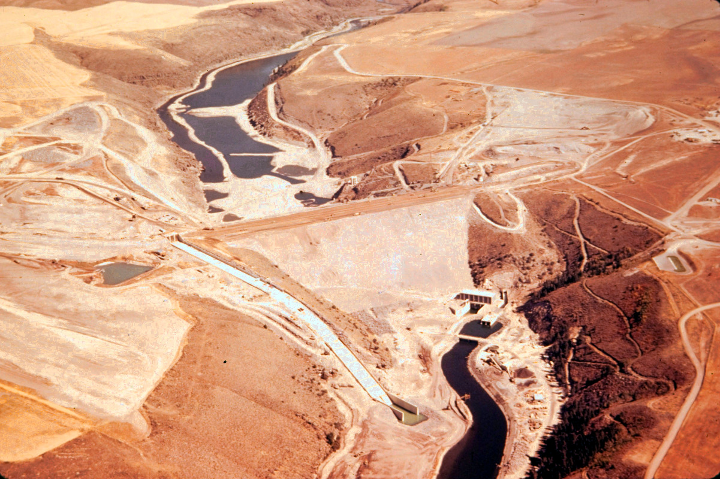
Notes:
corey

Slide 4
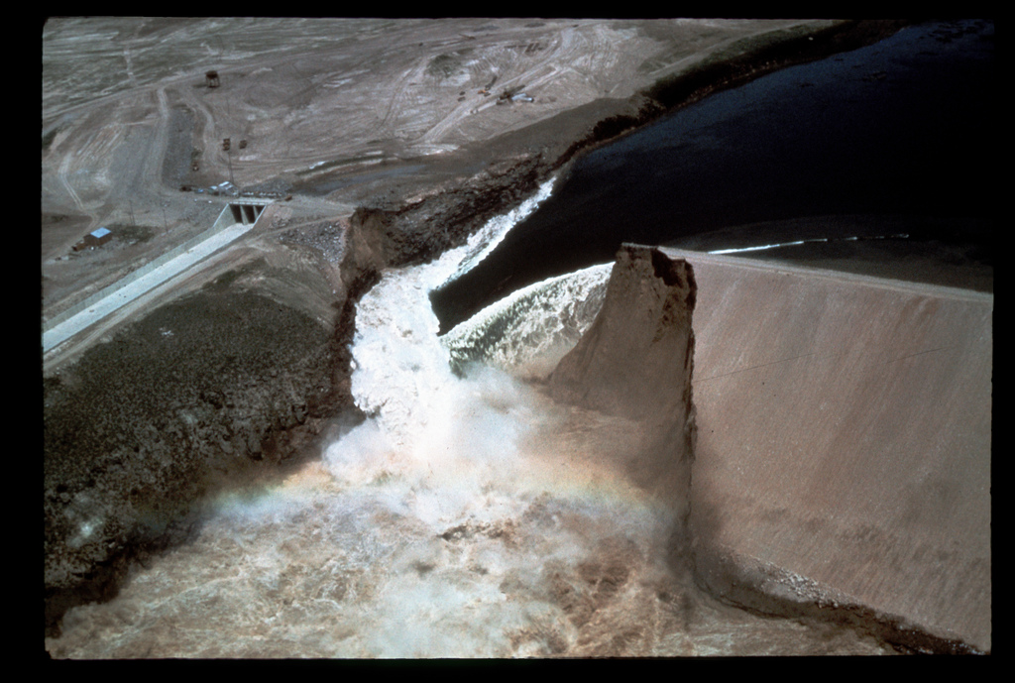
Notes:
corey

Slide 5
Notes:
corey

Slide 6
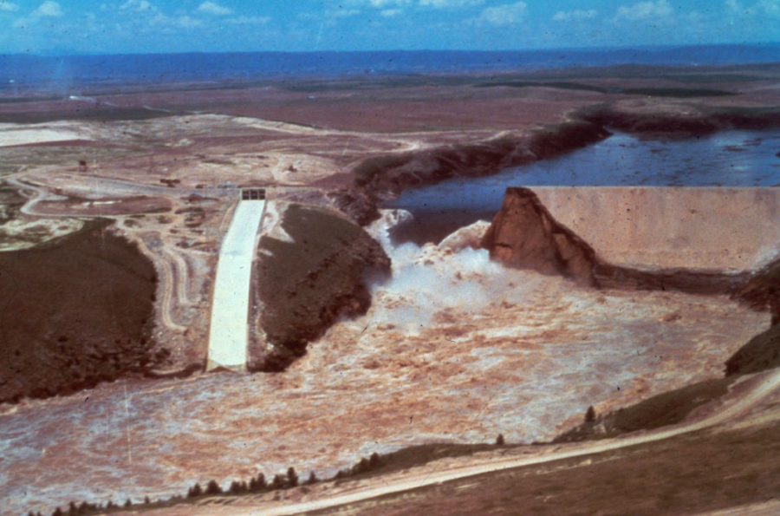
Notes:
corey

Slide 7
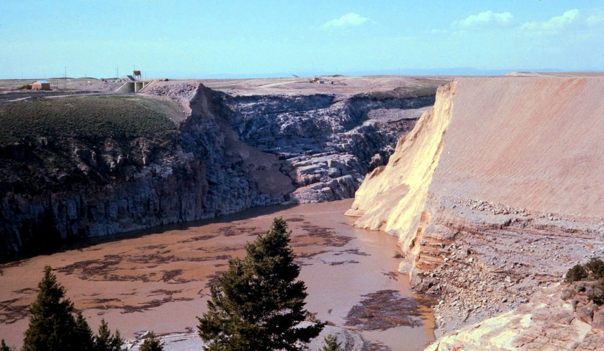
Notes:
corey

Slide 8
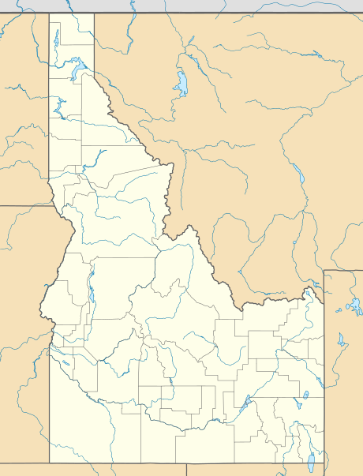
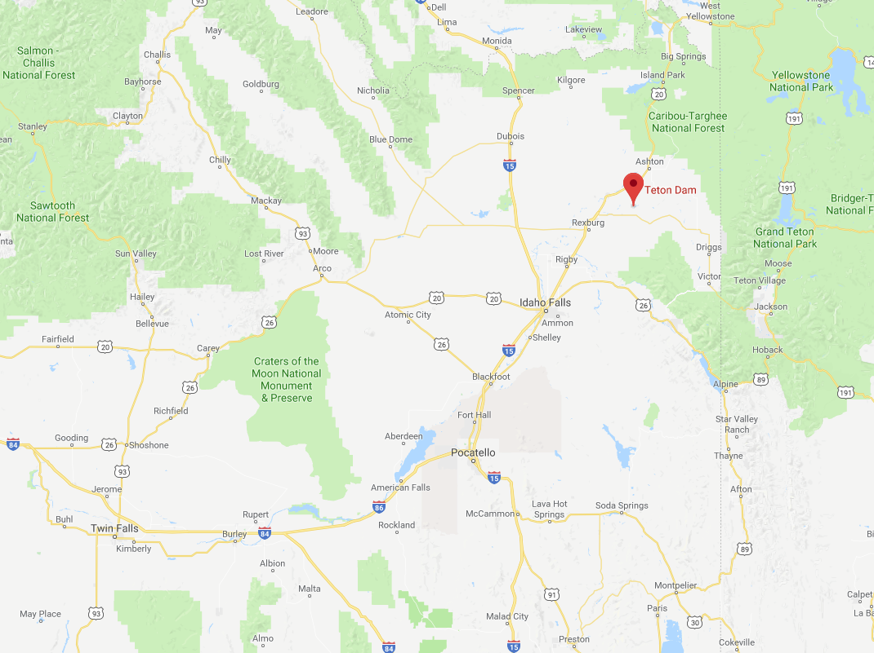
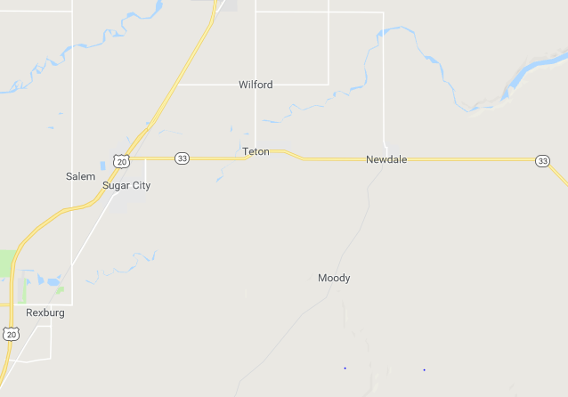
Location
Newdale, Idaho
14 miles from Rexburg, Idaho (BYU-Idaho)
On Teton Fork of Snake River
Yellowstone Ntl. Park
Teton Dam
BYU-Idaho
Newdale
Jackson Hole
BYU-Idaho
Pocatello
2 mi
Notes:
McKay

Slide 9
History
Built by the Bureau of Reclamation in 1972-1976
$48,825,000 in 1975
($173,000,000 in 2017)
Purpose: Provide constant water supply (irrigation), control spring runoff (flooding)

Slide 10
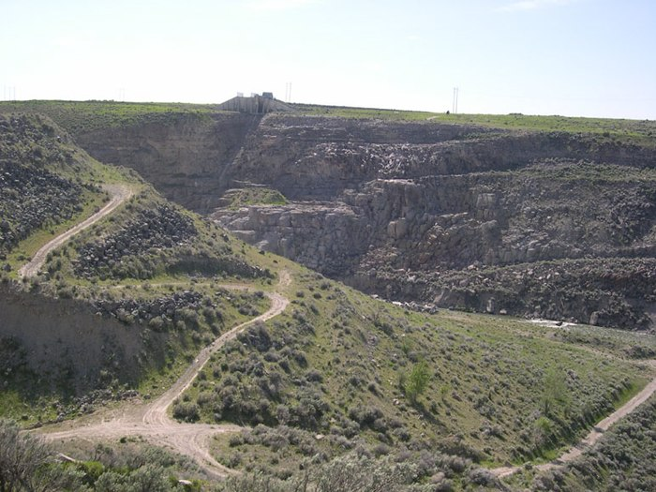
Construction site
Basalt and rhyolite foundation (highly permeable)
Many fissures in foundation
Notes:
McKay

Slide 11
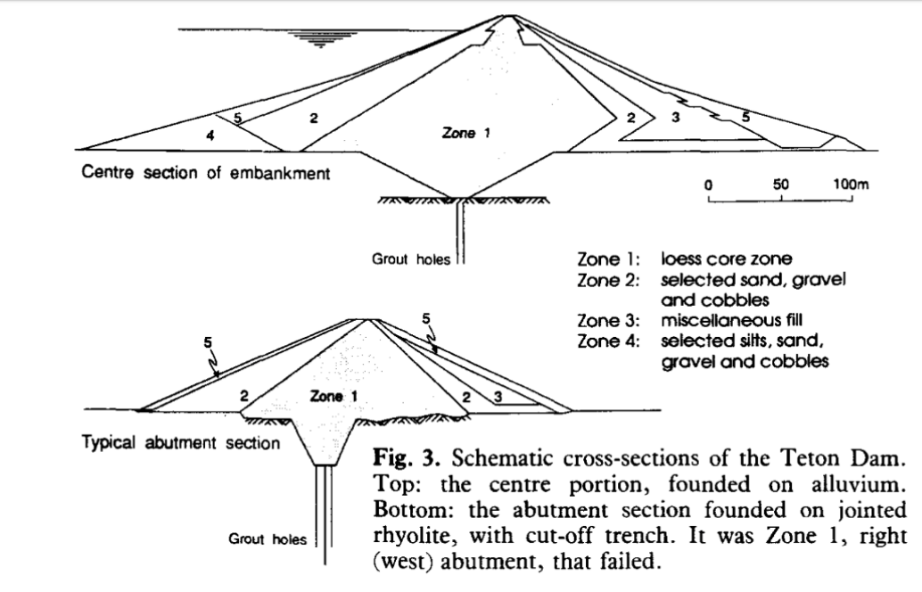
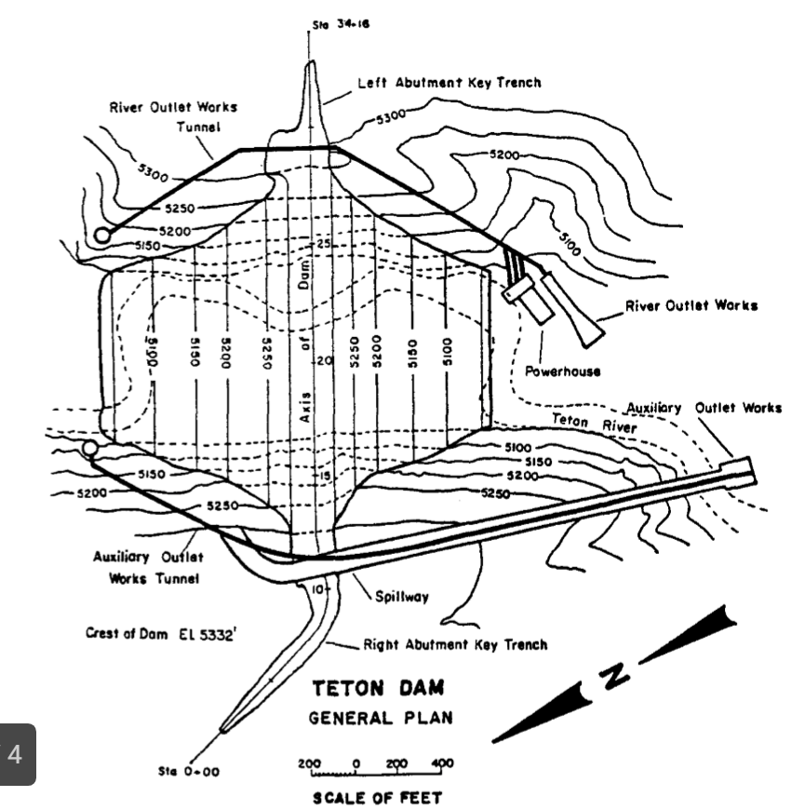
Dam Design
Planned to grout fissures
Underestimated amount of grout needed.
Notes:
Kirk

Slide 12
Dam Design
Height: 305 ft
Notes:
Kirk

Slide 13
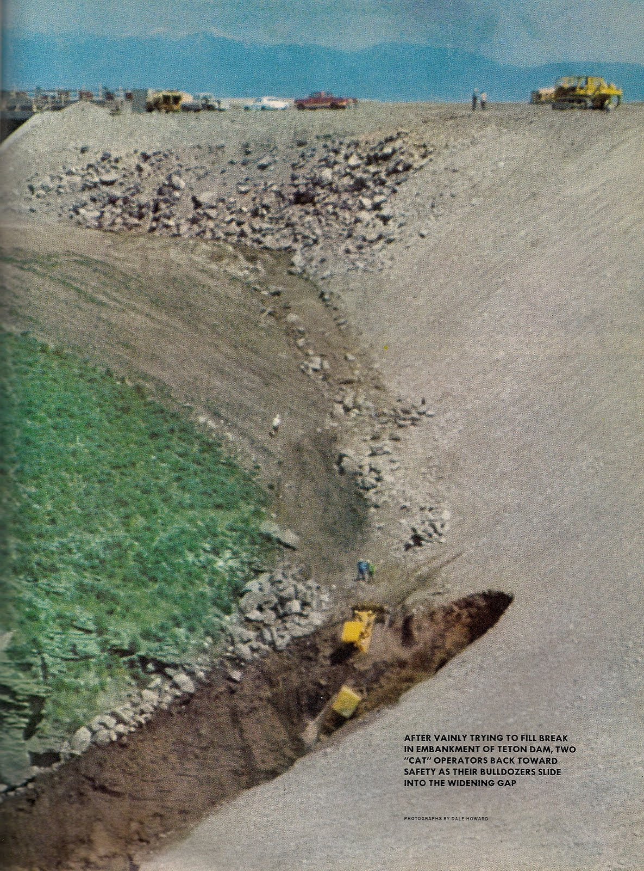
Failure
Failed on June 5, 1976
Dam reached 96% capacity
Drained 94 billion gallons in less than 6 hours (⅓ of Utah Lake)
Rapid Draining caused over 200 landslides in the river canyon
Failed at 5309 ft
Notes:
Kirk

Slide 14
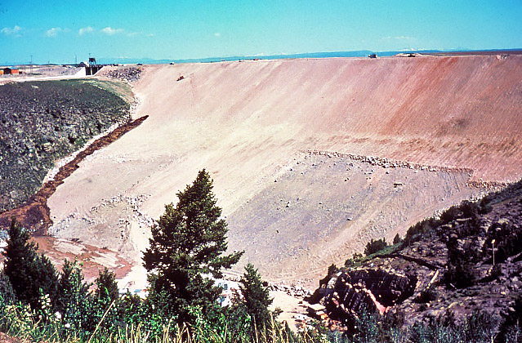
Notes:
McKay

Slide 15
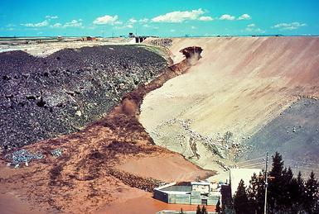
Notes:
McKay

Slide 16
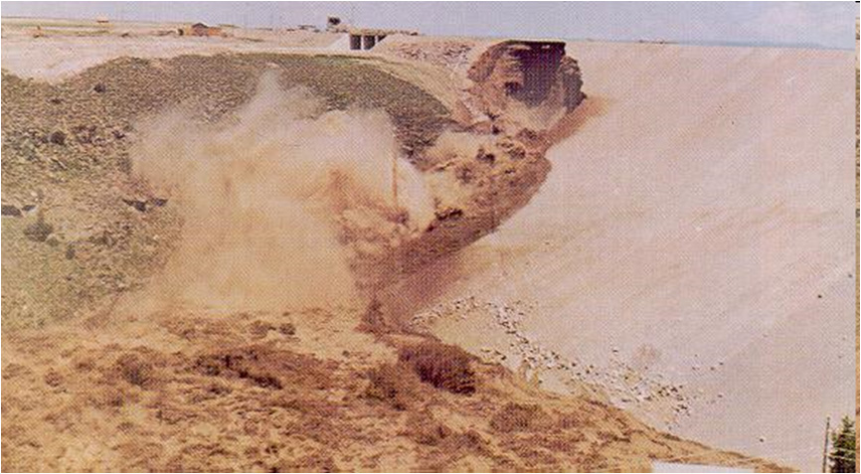
Notes:
McKay

Slide 17
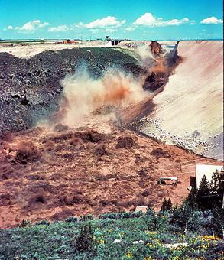
Notes:
McKay

Slide 18
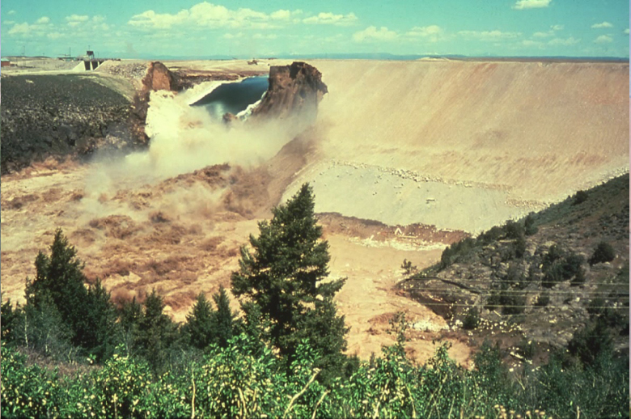
Notes:
McKay

Slide 19
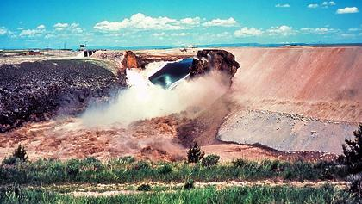
Notes:
McKay

Slide 20
Notes:
McKay

Slide 21
Notes:
McKay

Slide 22
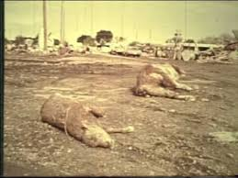
Aftermath
Death toll: 11 people, 13,000 Cattle
Estimated $2 billion in damage in 1976 ($6.6 billion in 2017)
Ended in American Falls reservoir (90 miles)
American Falls Reservoir
Notes:
Kirk

Slide 23
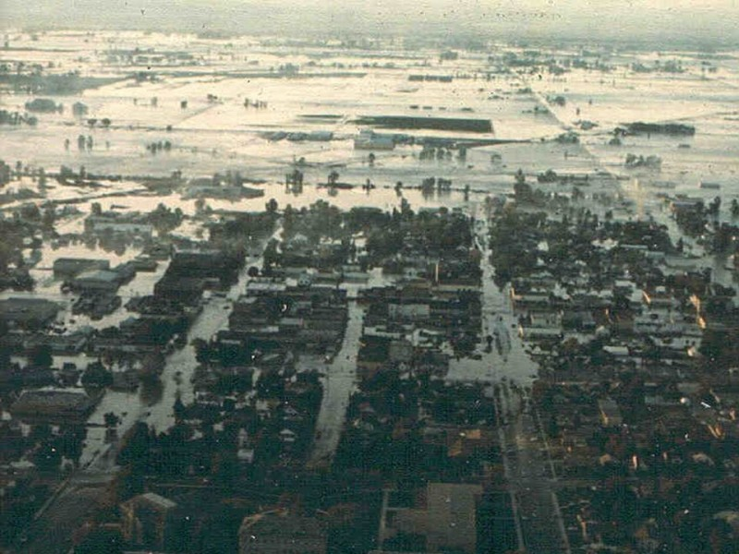
Notes:
Kirk

Slide 24
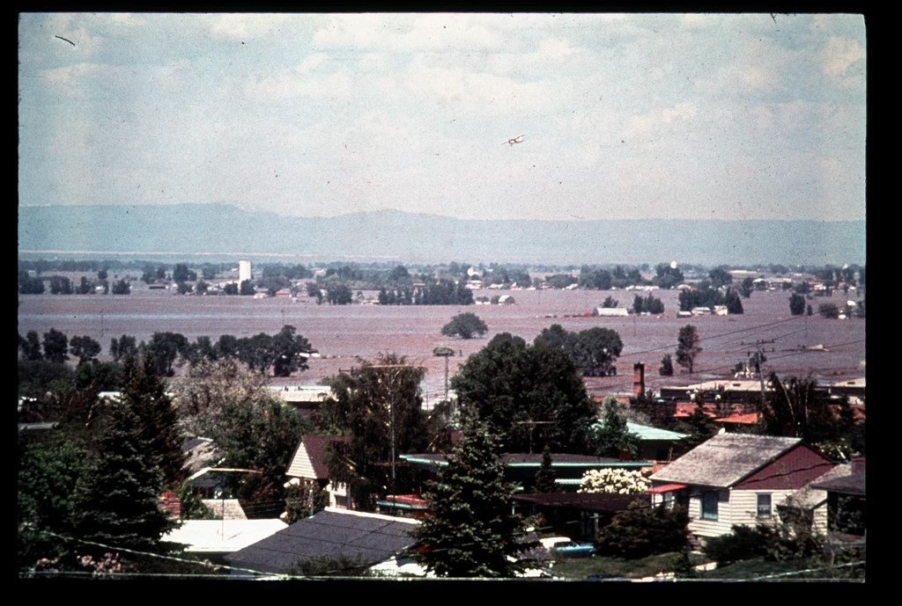
Notes:
Kirk

Slide 25
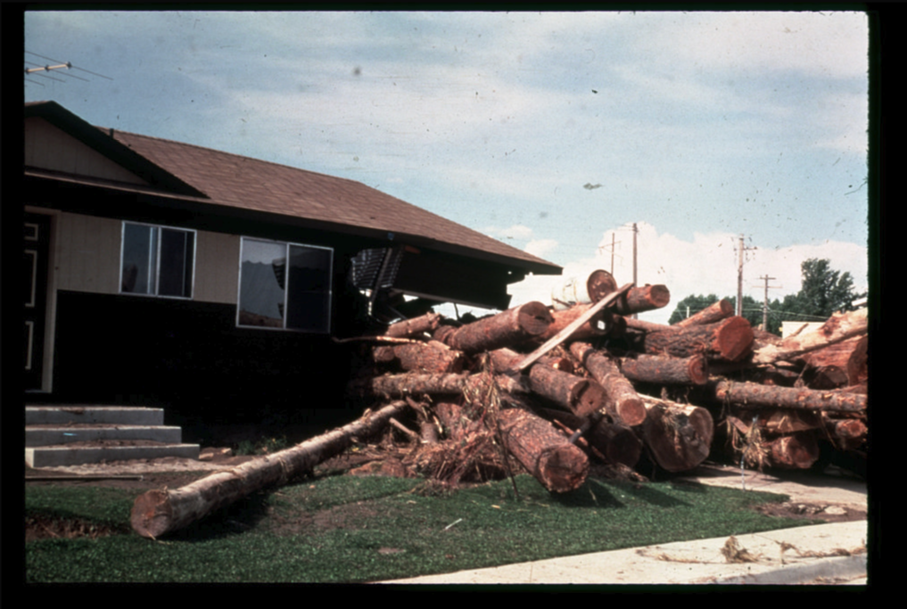
Notes:
Kirk

Slide 26
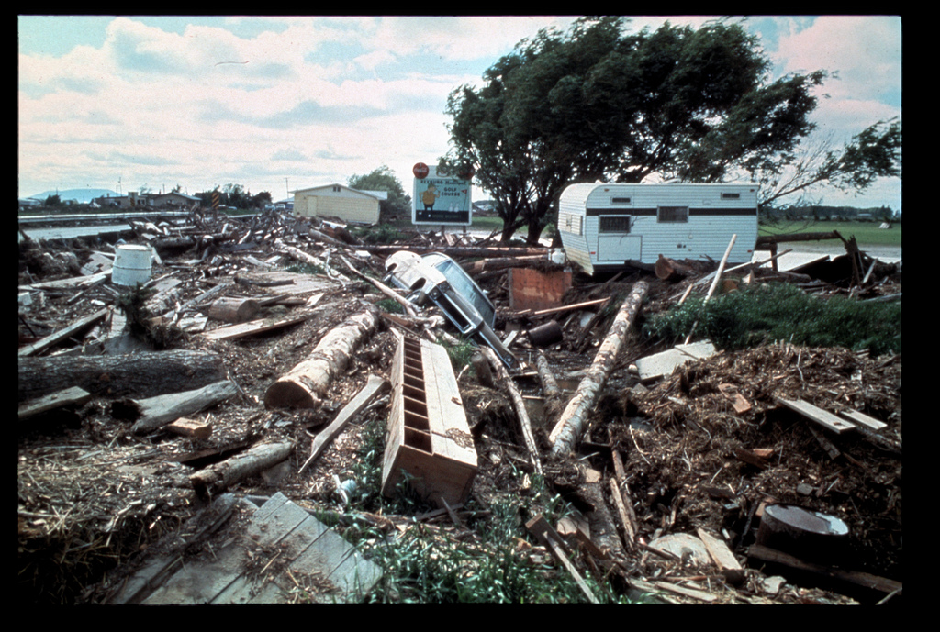
Notes:
Kirk

Slide 27
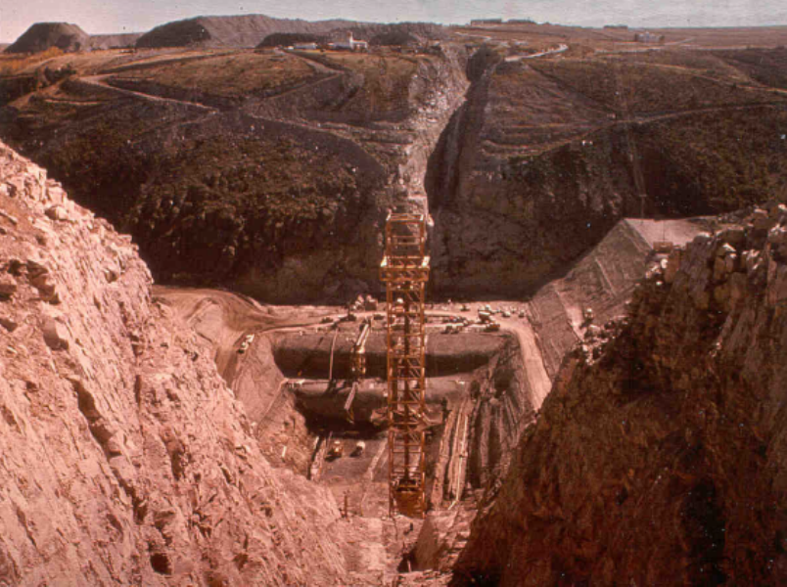
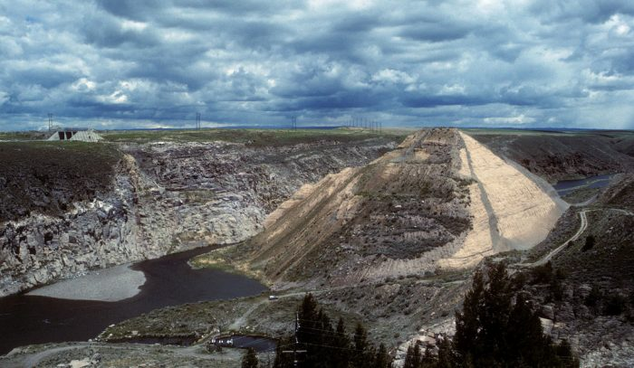
Post Analysis
Post analysis found that the clay core had a very low plasticity.
Notes:
Kirk

Slide 28
Our Analysis
K values (m/s)
Loess = 1×10⁻⁹ to 2×10⁻⁵ we could vary the value a bit because the article said the loess wasn't what it should have been
Gravel = 3×10-4 to 3×10-2
Coarse sand = 9×10-7 to 6×10-3
Medium sand = 9×10-7 to 5×10-4
Fine sand = 2×10-7 to 2×10-4
Varied values between a strong core and weak core
Used Seep2D for seepage analysis
Used UTEXASED for slope analysis
Notes:
Corey

Slide 29
Our Analysis Seep2D
Initially seepage was less than .25 cfs
2 days later, seepage increased to 20-30 cfs
Breached few hours later
Notes:
Corey

Slide 30
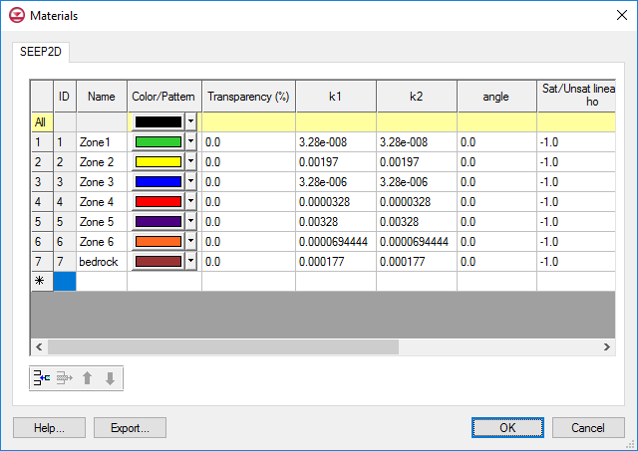
Our Analysis Seep2D
Strong Core
K values (m/s)
Loess = 1×10⁻⁹ to 2×10⁻⁵
Gravel = 3×10-4 to 3×10-2
Coarse sand = 9×10-7 to 6×10-3
Medium sand = 9×10-7 to 5×10-4
Fine sand = 2×10-7 to 2×10-4
Notes:
Corey

Slide 31
Our Analysis Seep2D
Weak Core
K values (m/s)
Loess = 1×10⁻⁹ to 2×10⁻⁵
Gravel = 3×10-4 to 3×10-2
Coarse sand = 9×10-7 to 6×10-3
Medium sand = 9×10-7 to 5×10-4
Fine sand = 2×10-7 to 2×10-4
Notes:
Corey

Slide 32
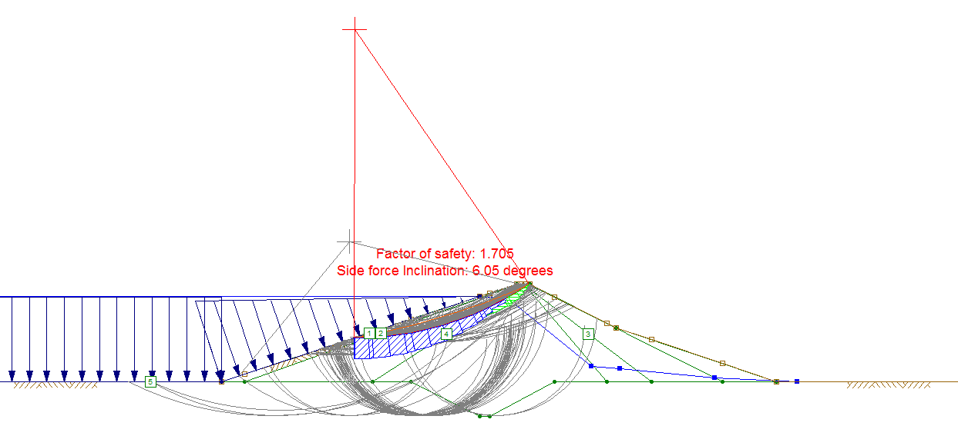
Our Analysis UTEXASED
Water behind dam with strong core
Notes:
Corey

Slide 33
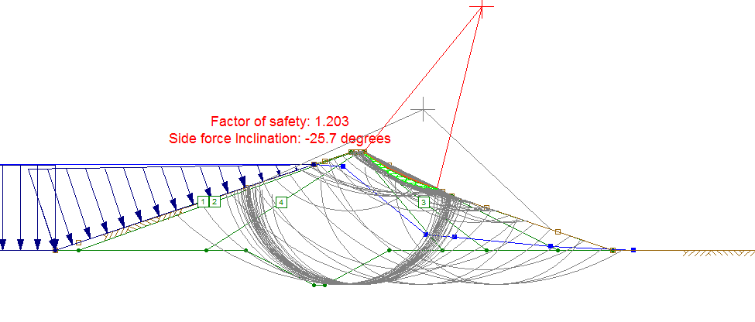
Our Analysis UTEXASED
Water behind dam with strong core (long term)
Notes:
Corey

Slide 34
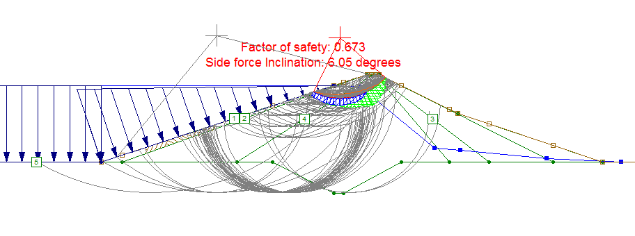
Our Analysis UTEXASED
Water behind dam with weak core (long term)
Notes:
Corey

Slide 35
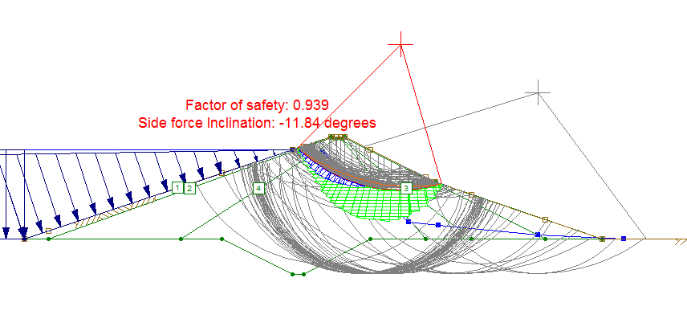
Our Analysis UTEXASED
Water behind dam with weak core (long term)
Notes:
Corey

Slide 37
Learning from our Analysis
The dam really wouldn’t fail due to slope stability (we made the core really weak)
The failure is due to seepage. . . which is really how it happened.
SURPRISE!!!
Let’s watch again . . .
Notes:
Corey

Slide 46
References
http://damfailures.org/case-study/teton-dam-idaho-1976/
https://www.usbr.gov/pn/snakeriver/dams/uppersnake/teton/projhistory.pdf
https://en.wikipedia.org/wiki/Teton_Dam
https://onlinelibrary.wiley.com/doi/abs/10.1111/j.1365-2451.1992.tb00347.x
https://www.usbr.gov/pn/snakeriver/dams/uppersnake/teton/geomorphology-full.pdf
SMALLEY, I. (1992), The Teton Dam: rhyolite foundation + loess core = disaster. Geology Today, 8: 19-22. doi:10.1111/j.1365-2451.1992.tb00347.x

Slide 47
References
http://snailhollow.cobabe.net/2016/06/remembering-teton-dam-disaster.html
https://www.flickr.com/photos/waterarchives/5901725095
http://damfailures.org/case-study/teton-dam-idaho-1976/
https://i.pinimg.com/originals/4a/02/d0/4a02d080143797b93fc5f58b3deadbf8.jpg
Note: Most photos are found using pyrited photos, we gave up trying to find original photos.

